Slide 1
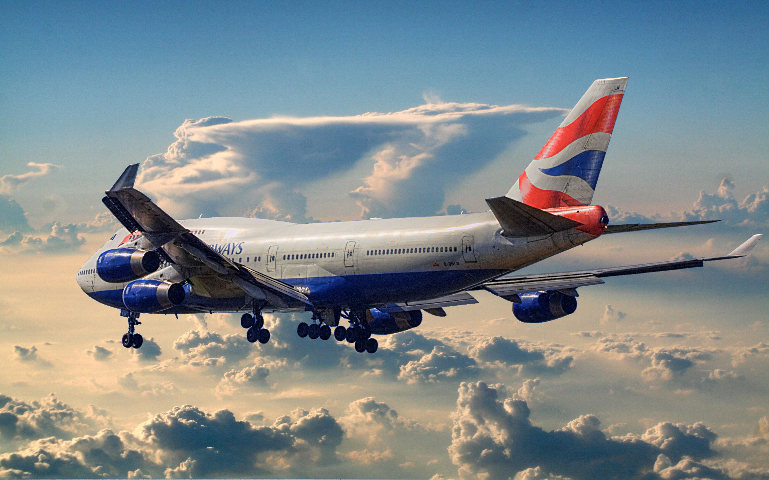
British Airways Reviews
Customer Feedback & Analysis
Power By:- Bhawna Saini
email - bhawanasaini350@gmail.com

Slide 2
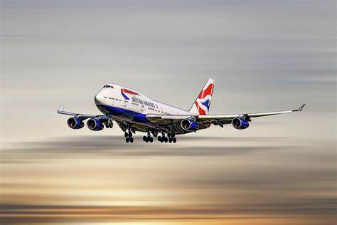
Table of contents
Introduction
Number of passenger vs booking completion
Business Implications:
Sales channel vs Booking completion
Business Recommendations:
Trip type vs booking completion
Business Recommendations:
Purchase lead vs booking completion
🔎 Key Takeaway:
Length of stay booking completion
Analysis
Flight hour vs booking completion
Analysis
Flight vs booking completion
Analysis
Top 10 Routes vs booking completion
Analysis
Top 20 Booking origins vs booking completion
Suggestion
Wants extra baggage vs booking completion
Analysis
Wants preferred seat vs booking completion
Insights & Suggestions
Fight duration vs booking completion
Features importance in random forest
Conclusion
Thank you

Slide 3
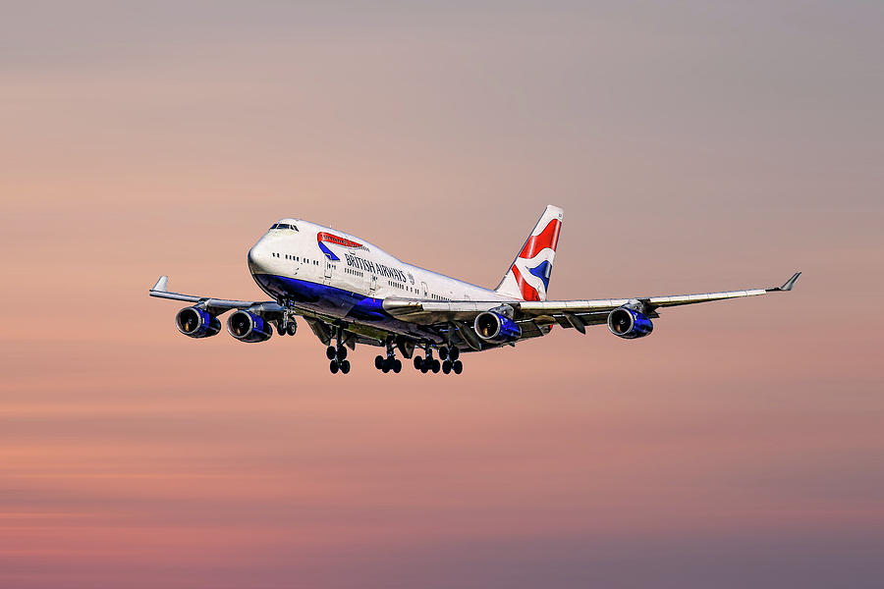
Introduction
An overview of British Airways' customer reviews, ratings, and overall service analysis.

Slide 4
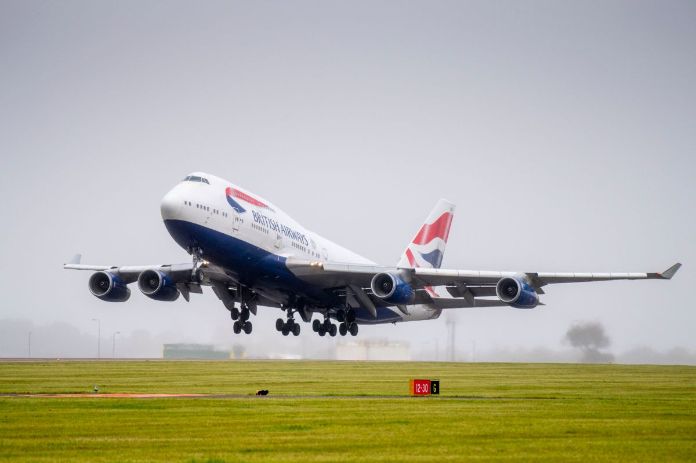
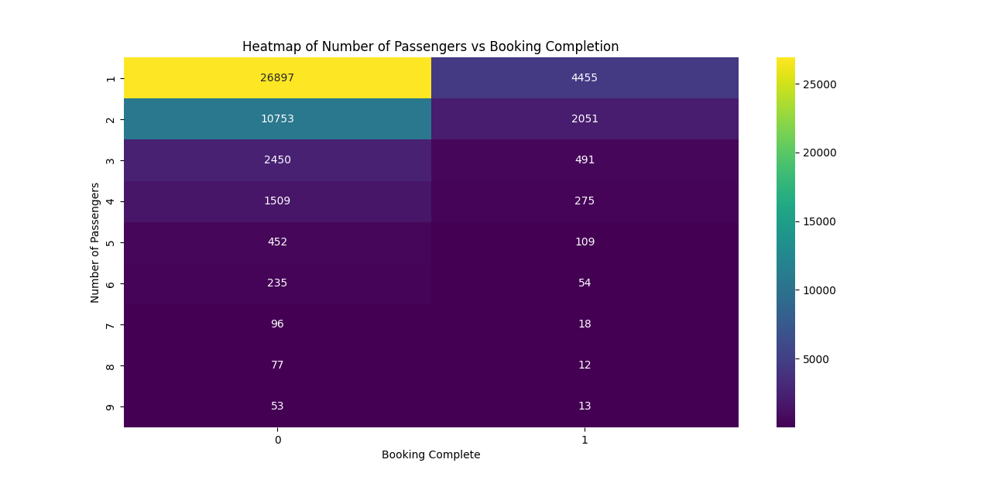
Number of passenger vs booking completion

Slide 5
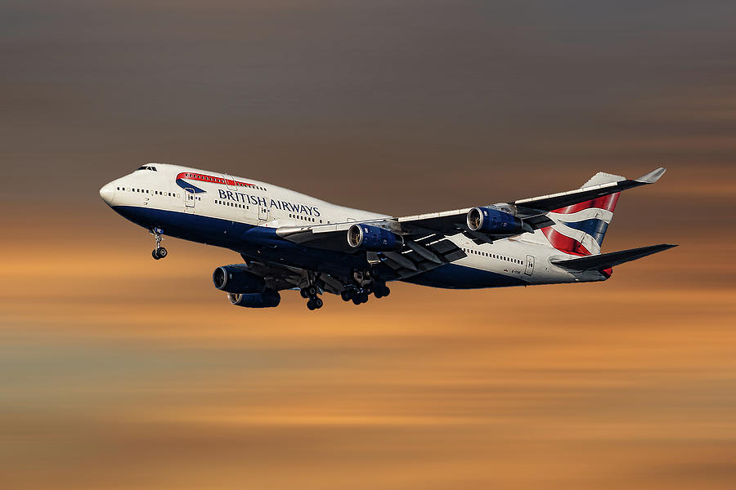
Business Implications:
Target solo travelers with promotions or discounts since they form the majority of bookings.
Improve group booking incentives to encourage larger groups to complete their bookings.
Optimize pricing and availability strategies for different group sizes.

Slide 6
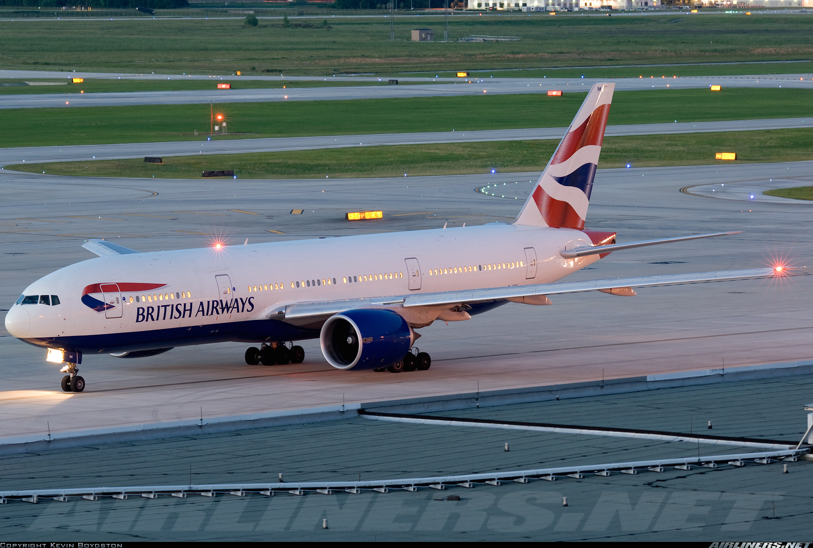
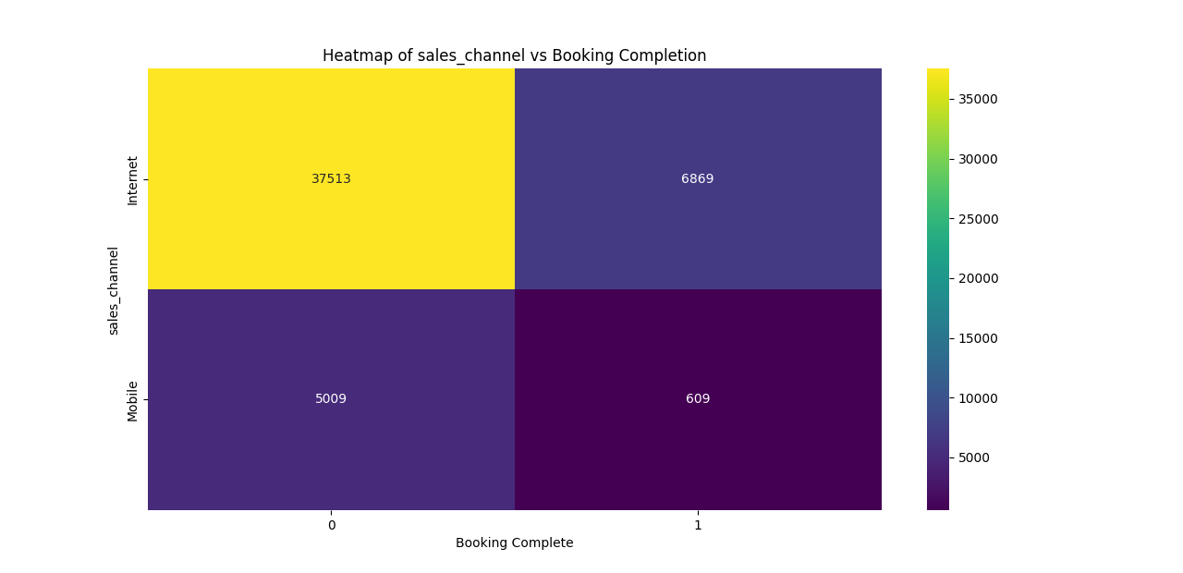
Sales channel vs Booking completion

Slide 7
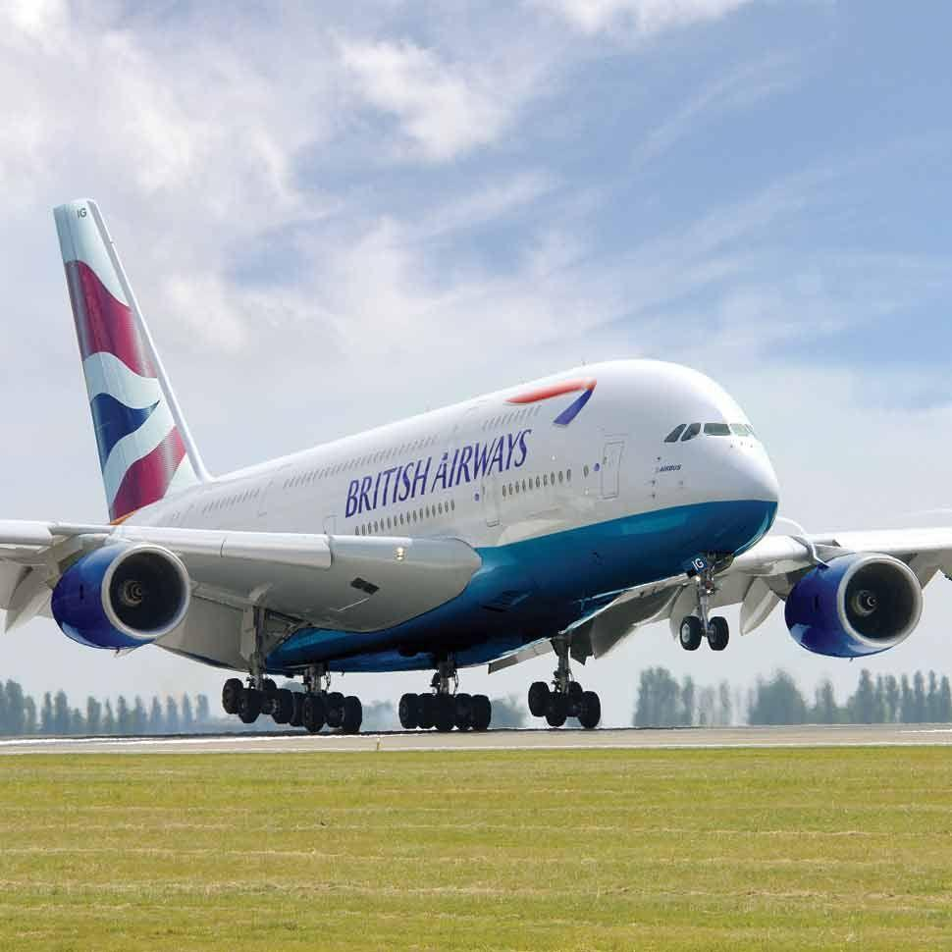
Business Recommendations:
Optimize the Mobile Booking Experience
Improve mobile UI/UX for a smoother experience.
Provide a one-click checkout option to reduce drop-offs.
Offer incentives for mobile users (e.g., discounts, exclusive offers).
Enhance Internet Booking Conversion
Simplify the checkout process.
Use retargeting strategies (email reminders, notifications) to encourage completion.
Ensure secure and fast payment options

Slide 8

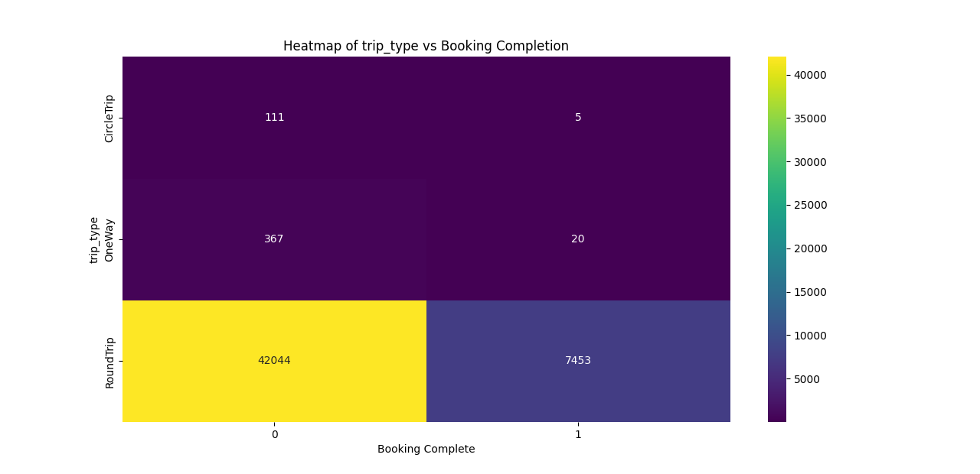
Trip type vs booking completion

Slide 9
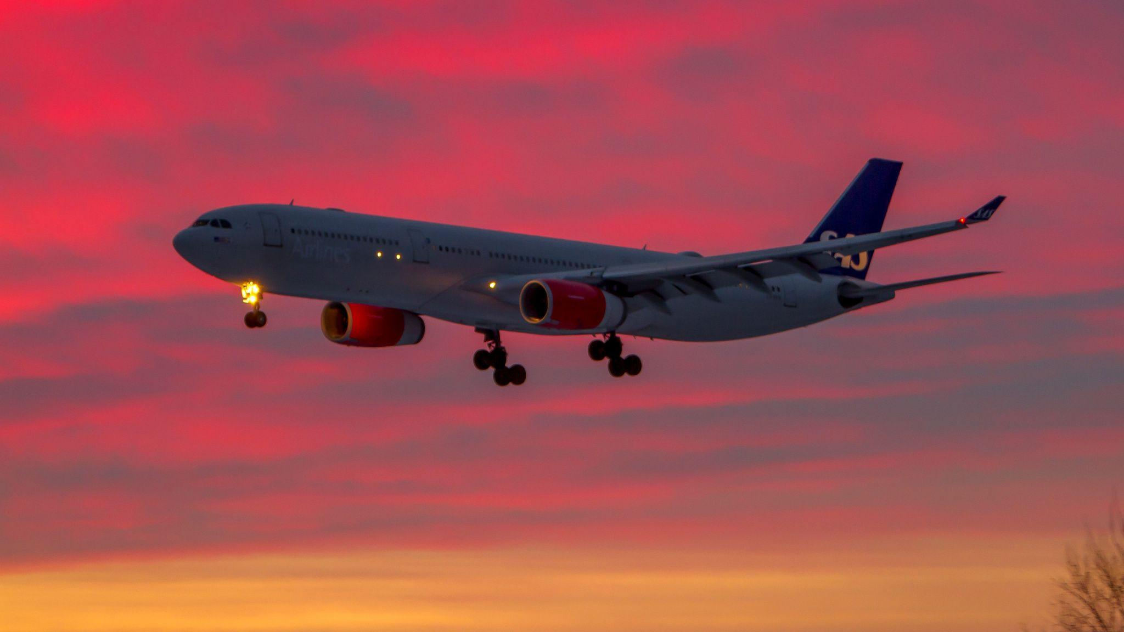
Business Recommendations:
Focus on Promoting Round Trips
Since round trips are the most preferred, offering discounts, loyalty programs, or bundled deals can increase conversion.
Improve One-Way and Circle Trip Bookings
Investigate why users are not completing these types of bookings:
Are prices too high?
Are there limited travel options?
Is the booking process complicated?
Consider special promotions or flexible booking options to attract users.

Slide 10

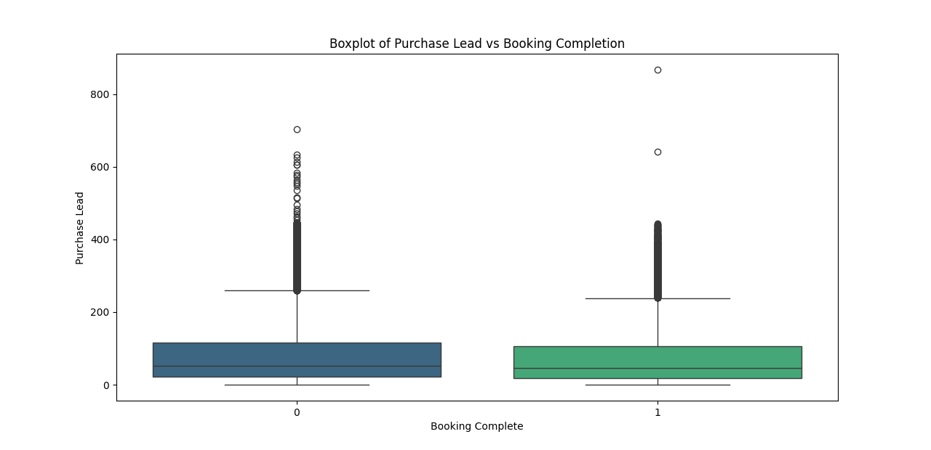
Purchase lead vs booking completion

Slide 11
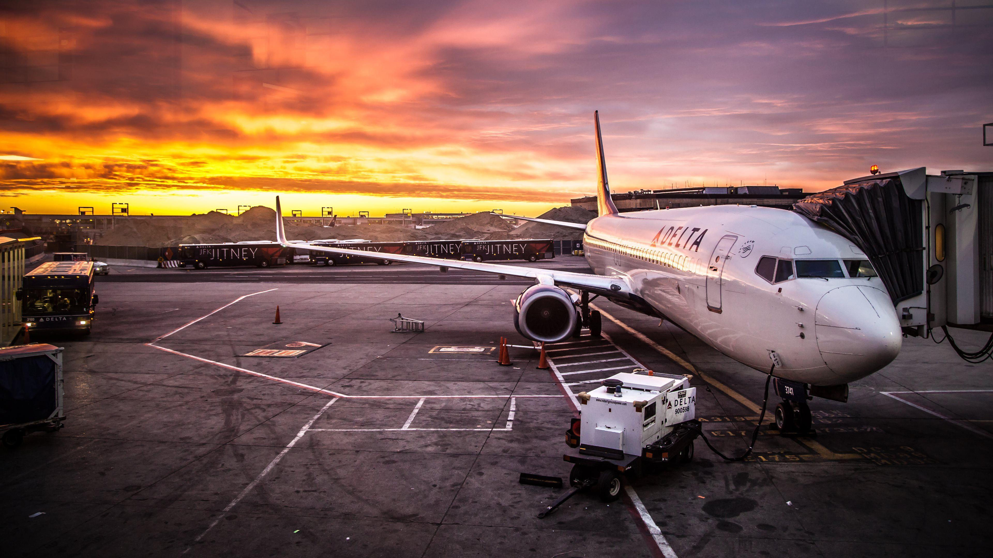
🔎 Key Takeaway:
While purchase lead time is not the sole factor determining booking completion, long purchase leads are associated with higher non-completion rates. Businesses should focus on reducing uncertainty for early bookers to enhance conversion rates.

Slide 12

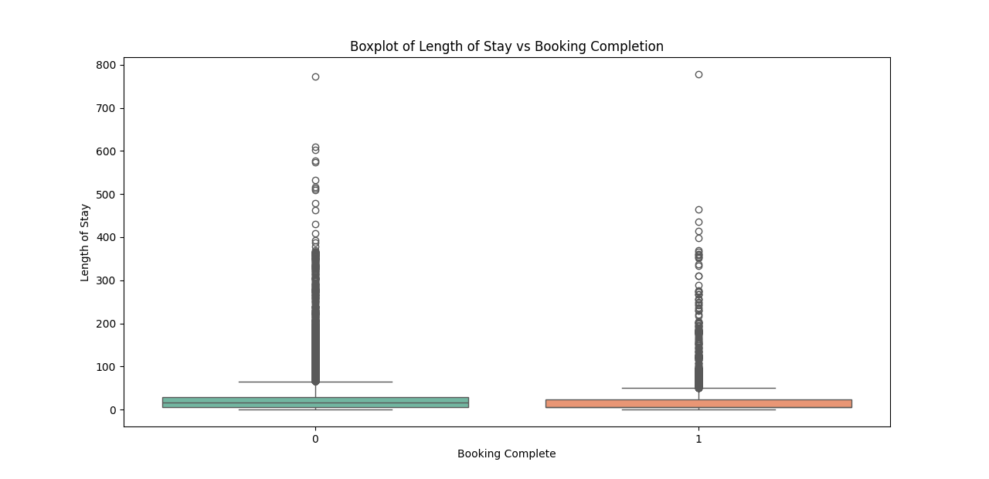
Length of stay booking completion

Slide 13

Analysis
1. The median **length of stay** is relatively low for both completed and non-completed bookings.
2. There are **significant outliers**, with some stays exceeding **700 days**, which may indicate anomalies.
3. Most bookings have a **length of stay below 50 days**, showing a right-skewed distribution.
4. The distribution is **similar** for both groups, suggesting length of stay **may not strongly impact booking completion**.
5. The presence of extreme values highlights the need for **data cleaning or further investigation**.

Slide 14

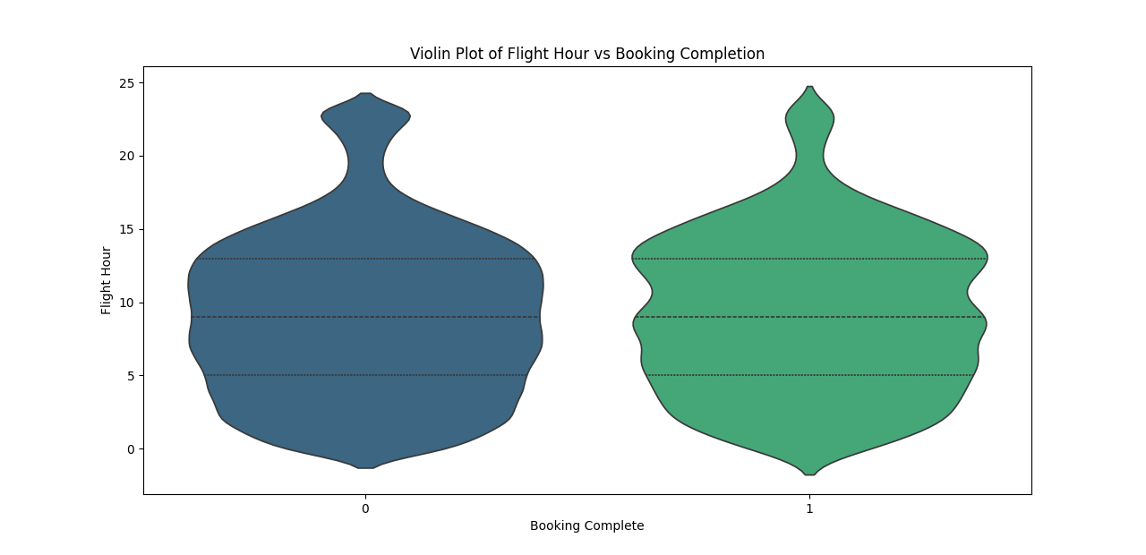
Flight hour vs booking completion

Slide 15

Analysis
Flight hours are widely distributed for both completed (1) and non-completed (0) bookings, showing a similar pattern.
The middle 50% of data (IQR) for both categories falls within a comparable range, with a slightly higher median for completed bookings.
The distribution is denser around shorter flight hours (0-10), indicating more bookings occur within this range.
There are long-tail distributions, meaning some bookings have significantly high flight hours, though these are less frequent.
The overall shape of both distributions is similar, implying flight duration may not be a strong differentiator in booking completion.

Slide 16

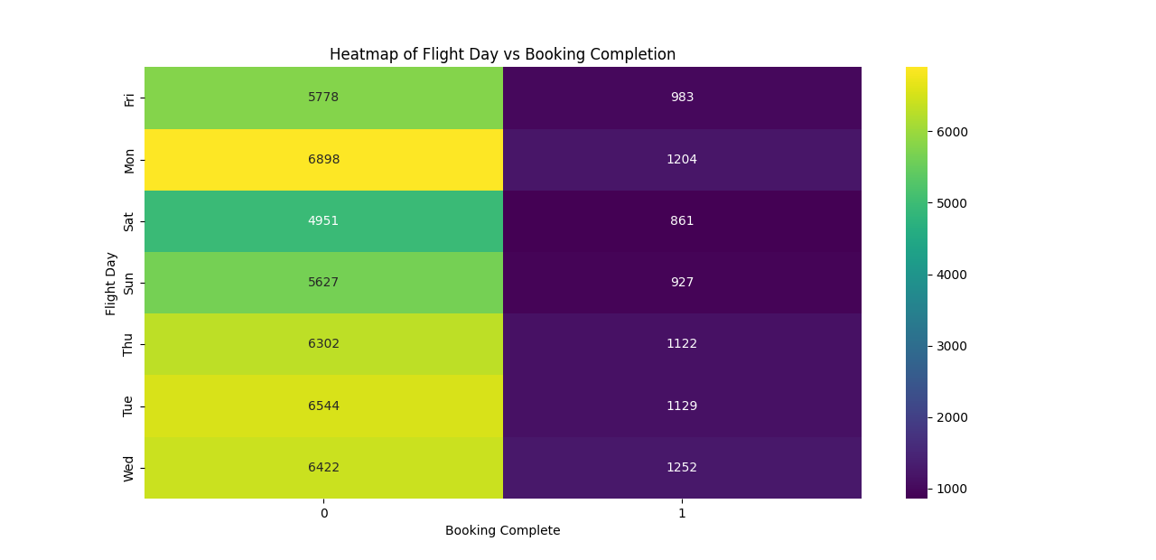
Flight vs booking completion

Slide 17

Analysis
Monday has the highest number of flight bookings (both completed and not completed).
Saturday has the lowest number of total bookings.
Completed bookings are significantly lower across all days compared to non-completed bookings.
Tuesdays and Wednesdays also see a high number of flight bookings.
Booking completion rates appear relatively consistent across all days, with no extreme fluctuations.

Slide 18

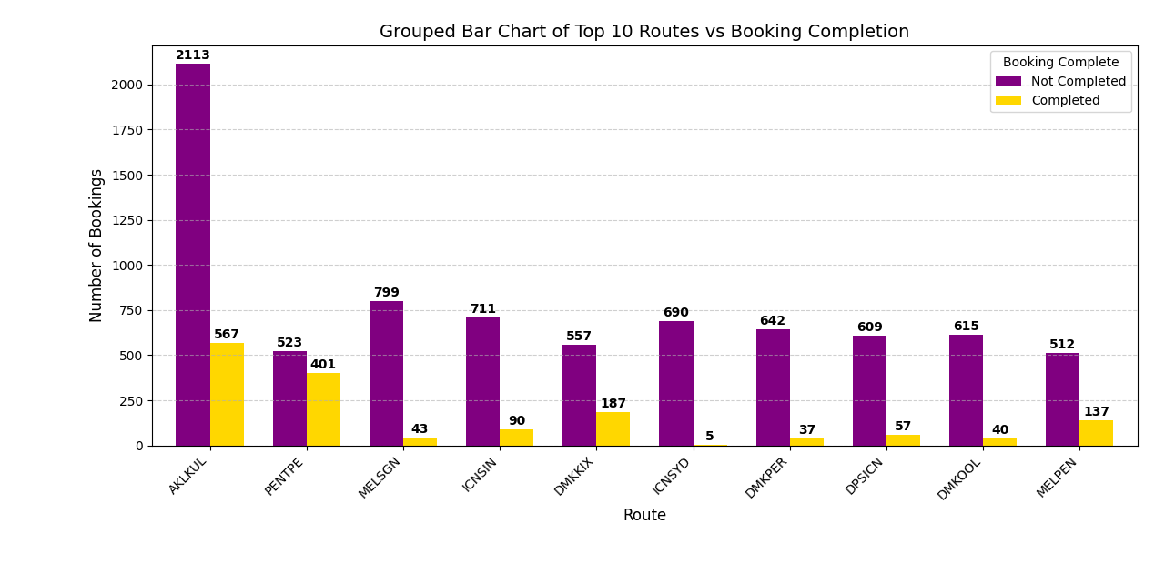
Top 10 Routes vs booking completion

Slide 19
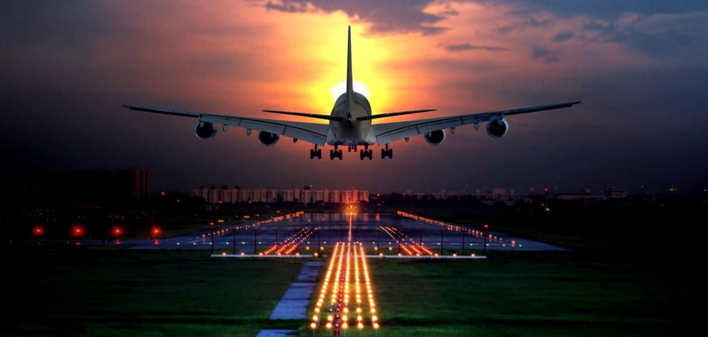
Analysis
Monday has the highest number of flight bookings (both completed and not completed).
Saturday has the lowest number of total bookings.
Completed bookings are significantly lower across all days compared to non-completed bookings.
Tuesdays and Wednesdays also see a high number of flight bookings.
Booking completion rates appear relatively consistent across all days, with no extreme fluctuations.

Slide 20

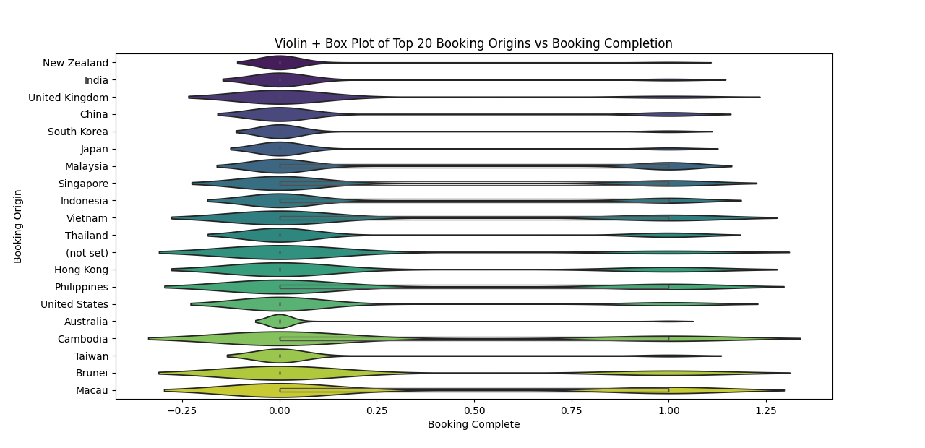
Top 20 Booking origins vs booking completion

Slide 21
Suggestions:
✅ **Improve targeted marketing** for high-volume but low-completion regions.
✅ **Analyze user behavior** in regions with uncertain booking patterns to reduce drop-offs.
✅ **Fix data gaps** related to missing booking origins for better accuracy.
✅ **Investigate pricing or service factors** affecting lower completion rates in certain countries.
✅ **Enhance user experience** for origins with erratic booking behavior to improve conversions.

Slide 22
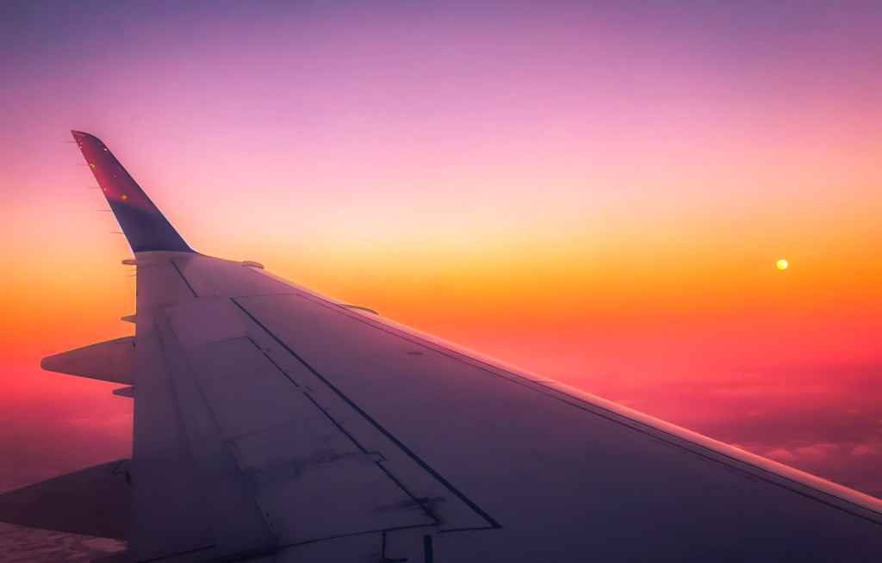
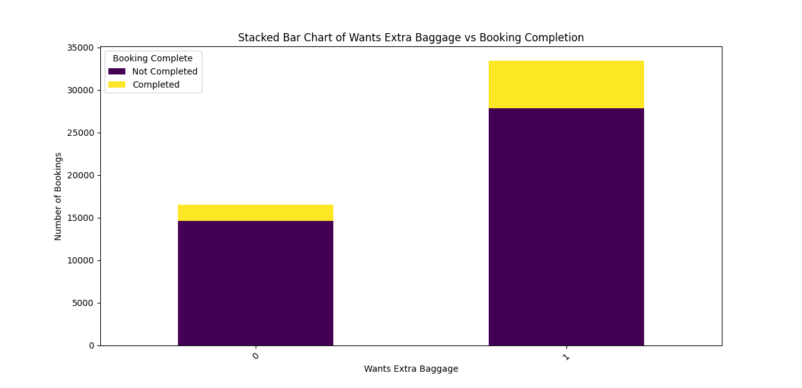
Wants extra baggage vs booking completion

Slide 23
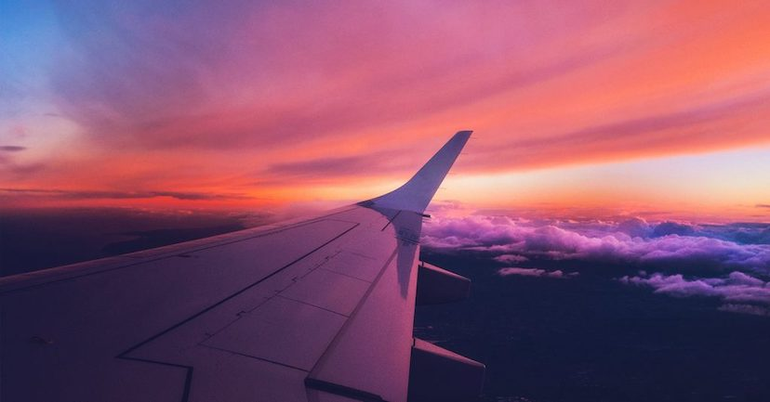
Analysis
1. Passengers wanting extra baggage have a higher booking completion rate than those who don’t.
2. A significant portion of users without extra baggage interest abandon their bookings.
3. Extra baggage demand indicates a potential revenue opportunity for airlines.
4. Targeted promotions on baggage add-ons could further boost booking conversions.
5. Suggestion: Offer bundled deals or discounts on baggage fees to encourage more bookings.

Slide 24
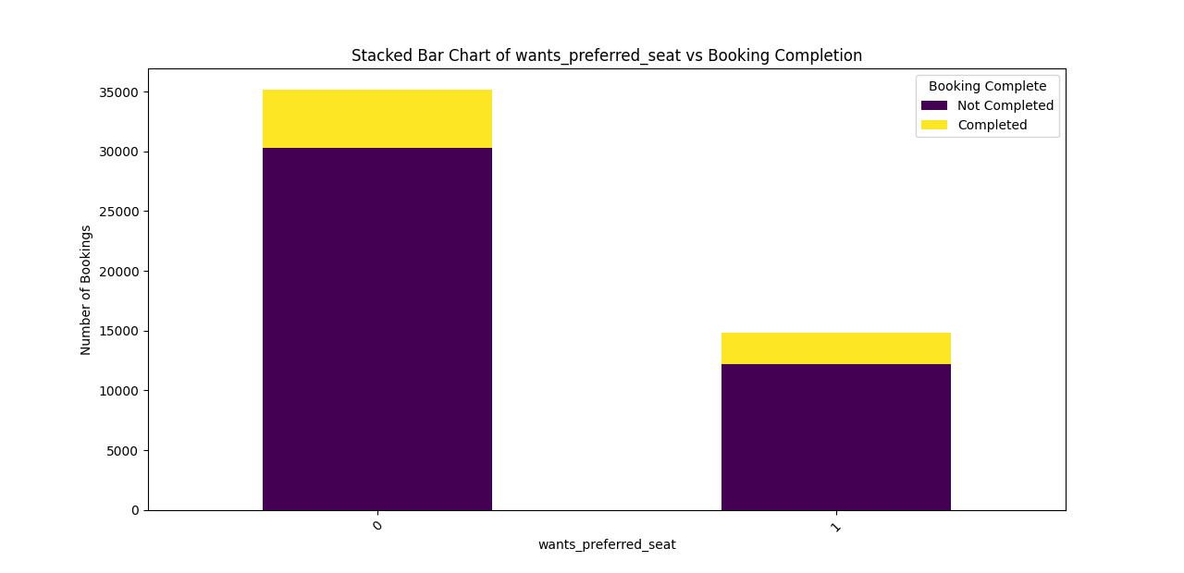
Wants preferred seat vs booking completion

Slide 25
Insights & Suggestions
1. Customers who opt for a preferred seat tend to have a higher booking completion rate than those who don’t.
2. A majority of users do not select a preferred seat, leading to a higher proportion of incomplete bookings.
3. Offering seat selection as a bundled package could enhance user experience and drive conversions.
4. Highlighting the benefits of seat selection (e.g., extra legroom, better views) may encourage more users to opt for it.
5. Suggestion: Introduce dynamic pricing for preferred seats or discounts for early seat selection to increase uptake.

Slide 26

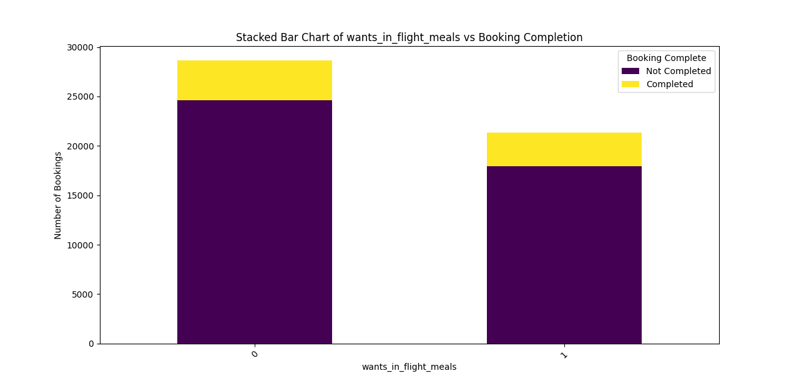
Wants in flight meals vs booking completion

Slide 27

Insights & Suggestions:
1. Customers who opt for in-flight meals show a slightly higher booking completion rate compared to those who don’t.
2. A significant number of users do not select in-flight meals, leading to lower engagement in this service.
3. Providing meal discounts or bundled offers with bookings may encourage more users to opt for in-flight meals.
4. Highlighting meal quality, variety, and special dietary options can improve customer interest.
5. Suggestion: Implement a loyalty program where frequent flyers receive discounts on in-flight meals to boost conversions.

Slide 28

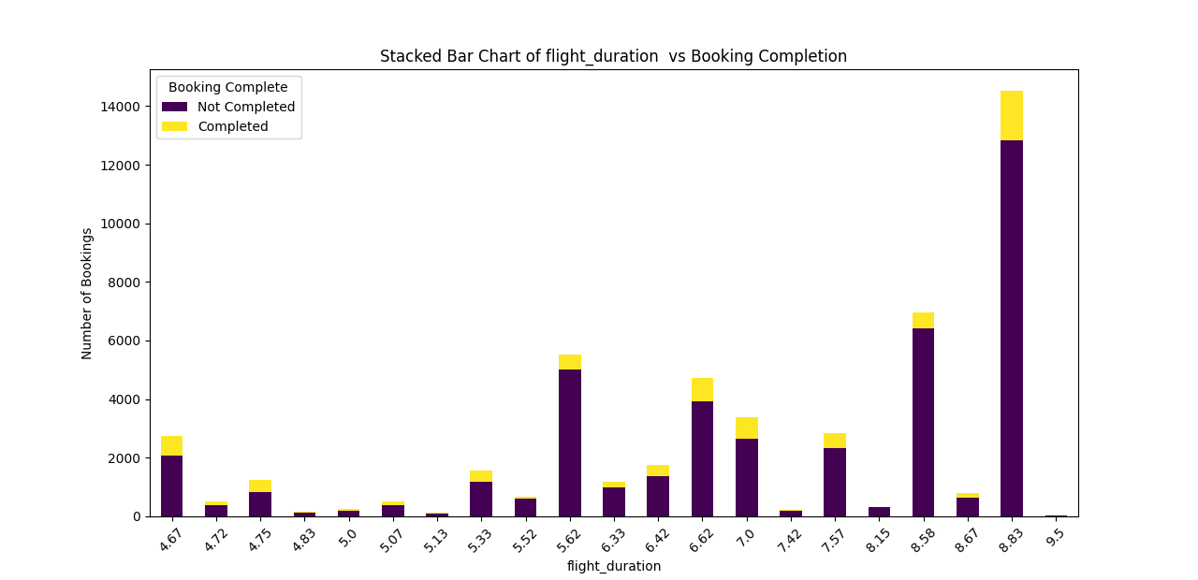
Fight duration vs booking completion

Slide 29

Insights & Suggestions:
1. Longer flight durations have a higher number of bookings, but also a significant proportion of incomplete bookings.
2. The highest booking completion rate appears in mid-range flight durations (around 6-7 hours).
3. Customers may hesitate to book longer flights due to cost, inconvenience, or lack of perks.
4. Airlines can offer better deals, comfort upgrades, or discounts on long-haul flights to improve booking rates.
5. Suggestion: Provide targeted promotions for long-duration flights, such as free Wi-Fi, extra baggage allowance, or seat upgrades.

Slide 30
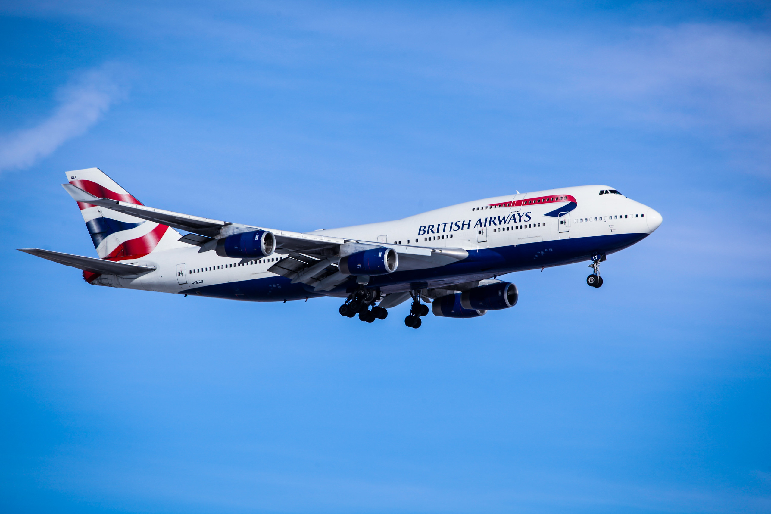
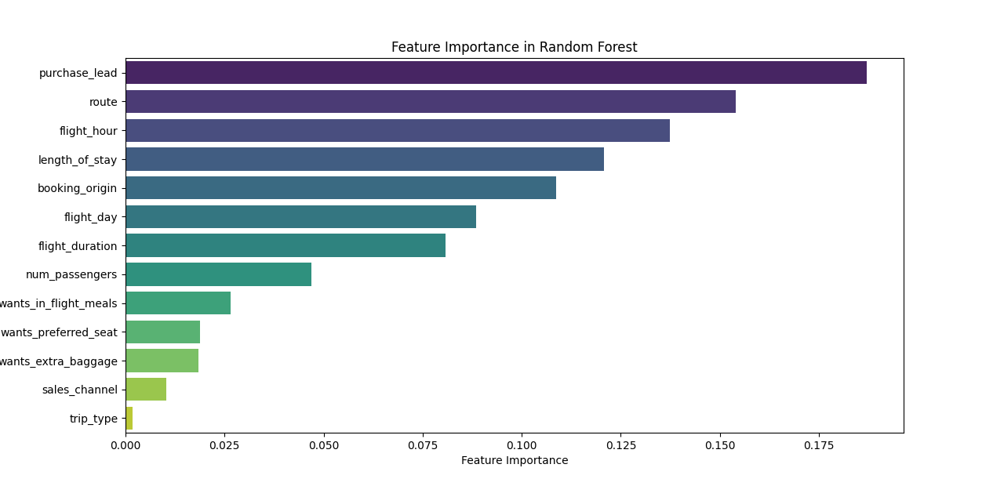
Features importance in random forest

Slide 31
Conclusion
Random forest Accuracy - 84.7%
Kneighbour Accuracy - 77.7%
Logistic regressin Accuracy - 85.5%
Linear regression Accuracy - 85.5%
SVM Accuracy- 63.5%
Gradint boosting Accuracy - 84.9%

Slide 32


